Slide 1


Project 4 - Perth House Prices
By Brad, Hardip and Ahmed

Slide 2
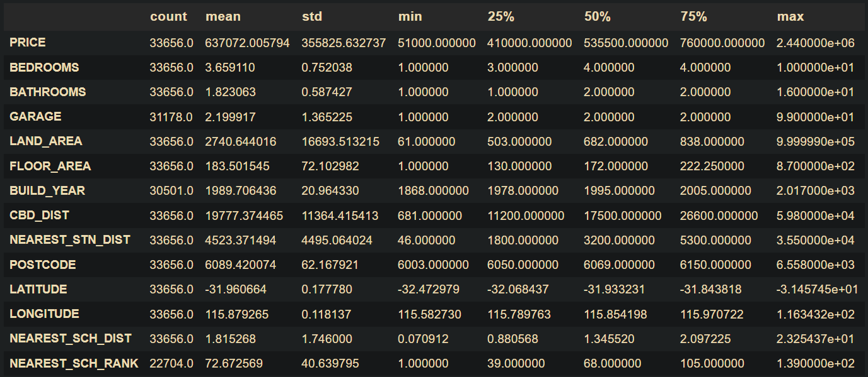
The Dataset
Dataset is from Kaggle which contains Data from house sales in the city of Perth.
This Dataset contained 33656 rows and 19 columns
Contained numerical data such as bedrooms, bathrooms, garages, floor area
Contained categorical data such as nearest school, nearest station and suburb

Slide 3
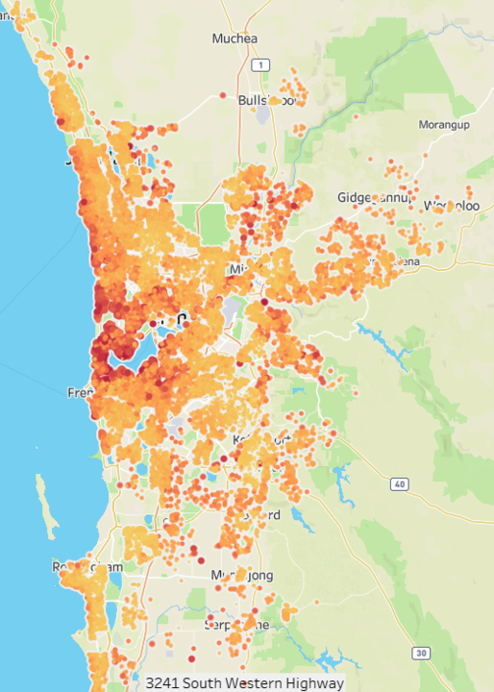
Perth House Prices
We are looking to create a regression model to predict the price of houses based on given features.
This map shows the sale prices of houses. We could see that the houses are more expensive in certain areas.

Slide 4
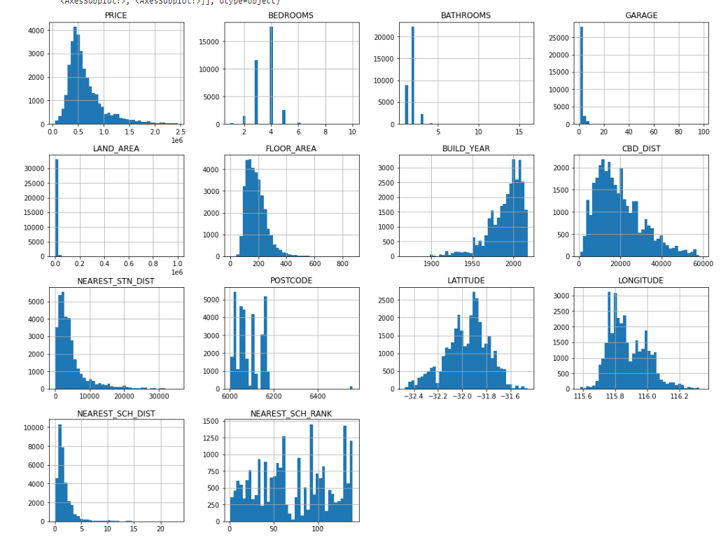
EDA
These graph show the spread of the data in our numerical columns.
We do experience a large spread of results in columns such as garages (max - 99).
We also experience a large spread in house prices, most common is around $480,000 and max is nearly $2,500,000

Slide 5
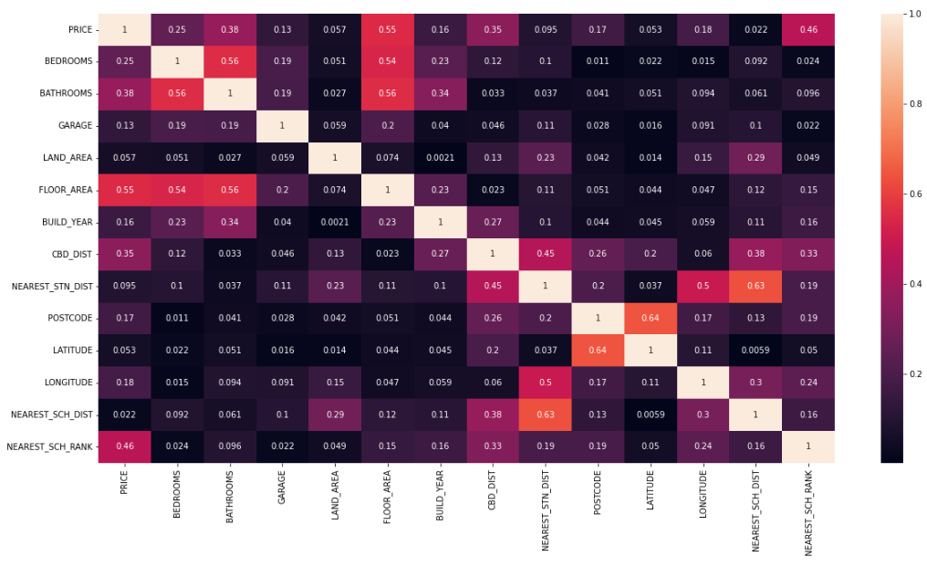
EDA
This Graph shows the correlation between the variables.
The highest correlated features with the price is floor area, nearest school rank, bathrooms, CBD distance

Slide 6
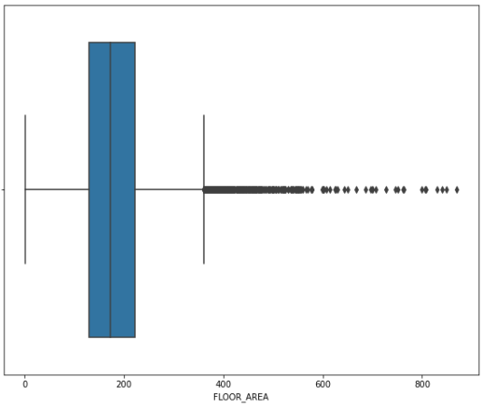
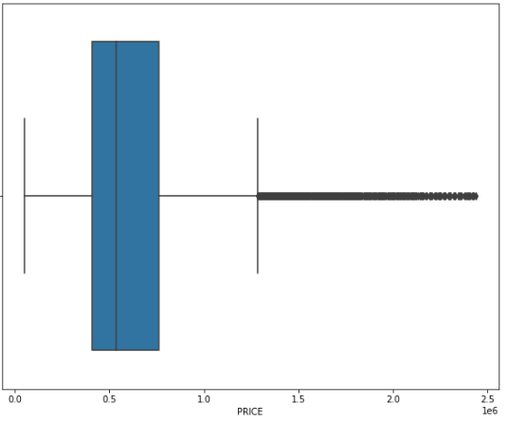
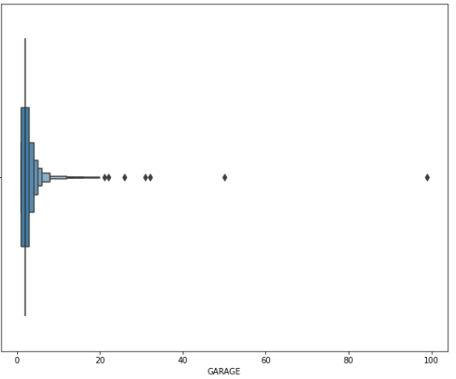
EDA - Outliers
We experience outliers in our dataset. We have data on a variety of houses with houses over $1 million.
We also observed extreme values in the garage category which we have dropped in the data cleaning process

Slide 7
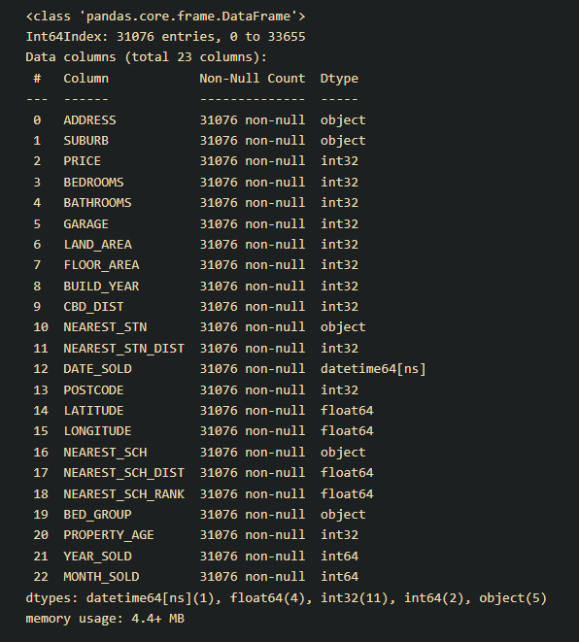
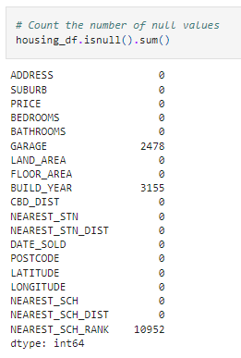
Data Cleaning
As mentioned previously we have dropped the rows with houses with more than 9 garage units.
We have experience null values in the dataset in the garage, build year, and nearest school rank columns. In this approach we replaced the missing values with the mode so that we could keep the data.
We swapped the year built column with the age of the property
We had to change the column types for a few different columns
We have extracted the date from date_sold and replaced it with month_sold and year_sold

Slide 8
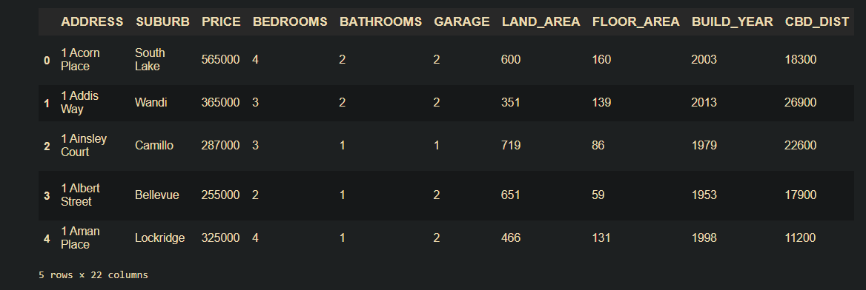
Clean DF

Slide 9
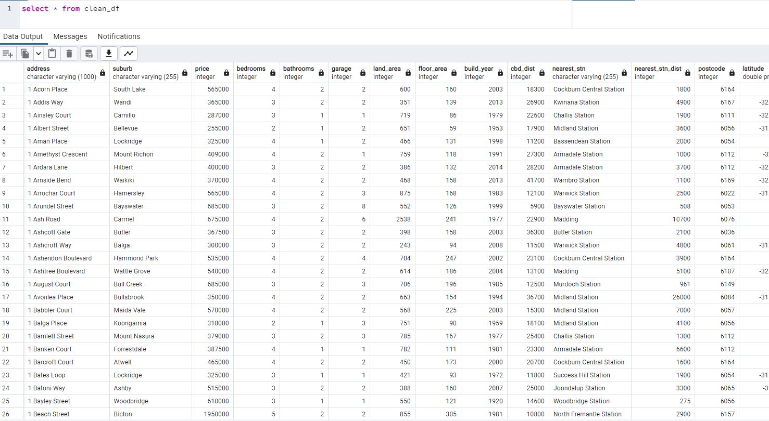
Data Storage
We loaded our data in our database using postgres and our database tool is PGadmin.

Slide 10

Machine Learning Model
We started with a Linear regression model to predict the price of housing.
As we had categorical data we used get dummies to convert to numerical data.
The target variable is the price and the rest of the columns are the features
We used training data to train the model and then used the testing data to make predictions.
Final scores were: r2 - 0.75057, RMSE - 178309.131621

Slide 11
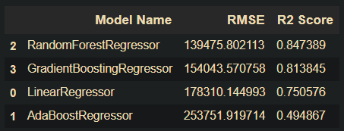
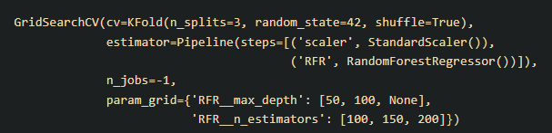

Machine Learning Model - Optimized
To optimise the data we have dropped columns, and binned some of the categorical details.
We have also tested 4 different models to find the best score, we found that random forest regression model was the best with the lowest RMSE score and highest r2 slides.
We also scaled the data using the standard scaler and tested the parameters to see the best combination
Final optimised results - r2 = 0.84735
RMSE = 139489.746371

Slide 12
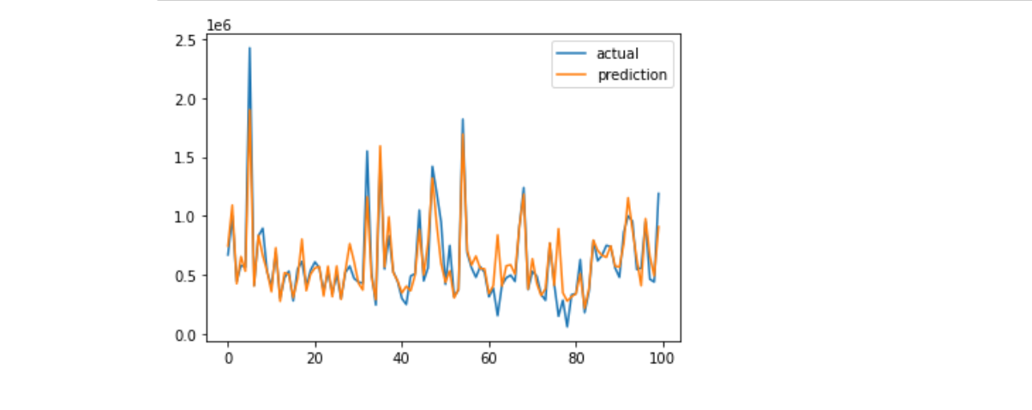
Predicted vs Actuals

Slide 13
What Would We Do Next Time
Next time we would like to experiment with the columns so that we can try and bring down the RMSE score.
We would also look into the variance inflation factors to find out what columns are affect our scores.
If we had more more time we would make machine learning models with different segments of data.
We would also like to trail more parameters to improve the model

